Slide 1
Module:1 Overview Of Software Engineering
BOOK: Ian Sommerville
Chapter 1

Slide 2
Contents
Nature of Software,
Software Engineering,
Software process,
project, product, Process
Models
Classical Evolutionary models,
Introduction to Agility - Agile Process-
Extreme programming
- XP Process –
Principles of Agile Software Development framework –
Overview of System Engineering

Slide 3
What is a Software?
In a computer system, the software is basically a set of instructions or commands that tell a computer what to do. In other words, the software is a computer program that provides a set of instructions to execute a user’s commands and tell the computer what to do.
What is program?
A step by step instructions, to perform a specific task, on a computer in a prog language.
software system usually consists of a number of separate programs, configuration files, which are used to set up these programs, system documentation, which describes the structure of the system, and user documentation, which explains how to use the system and web sites for users to download recent product information
Software is for commercial purpose.

Slide 4
Software Components
A program is a subset of software and it becomes software only if documentation and an operating procedure manual are prepared.
Program
Documents
Software documentation consist all the description, programs, graphics and instructions pertaining to design, coding, testing and preparation of software.
Operating Procedure(User Manual & Operational Manual)
Provides information about what software is how to work with it how to install it on your system and how to control all the activities of the software.

Slide 5
Nature of Software
Generic products : These are stand-alone systems that are produced by a development organisation and sold on the open market to any customer who is able to buy them. Examples of this type of product include software for PCs such as databases, word processors, drawing packages and project management tools.
Customised (or bespoke) products: These are systems which are commissioned by a particular customer. These are systems which are commissioned by a particular customer. A software contractor develops the software especially for that customer. Example: VTOP

Slide 6
seven broad categories of computer software present continuing challenges for software engineers:
System software—a collection of programs written to service other programs. Some system software (e.g., compilers, editors, and file management utilities) processes complex, but determinate, information structures. Other systems applications (e.g., operating system components, drivers, networking software, telecommunications processors) process largely indeterminate data.
Application software—stand-alone programs that solve a specific business need
Engineering/scientific software—has been characterized by “number crunching” algorithms. Applications range from astronomy to volcanology, from automotive stress analysis to space shuttle orbital dynamics, and from molecular biology to automated manufacturing
Embedded software—resides within a product or system and is used to implement and control features and functions for the end user and for the system itself.
Product-line software—designed to provide a specific capability for use by many different customers. Product-line software can focus on a limited and marketplace (e.g., inventory control products) or address mass consumer markets (e.g., word processing, spreadsheets, computer graphics, multimedia, entertainment, database management, and personal and business financial applications).
Web applications—called “WebApps,” this network-centric software category spans a wide array of applications
Artificial intelligence software—makes use of nonnumerical algorithms to solve complex problems that are not amenable to computation or straightforward analysis. Applications within this area include robotics, expert systems, pattern recognition

Slide 7
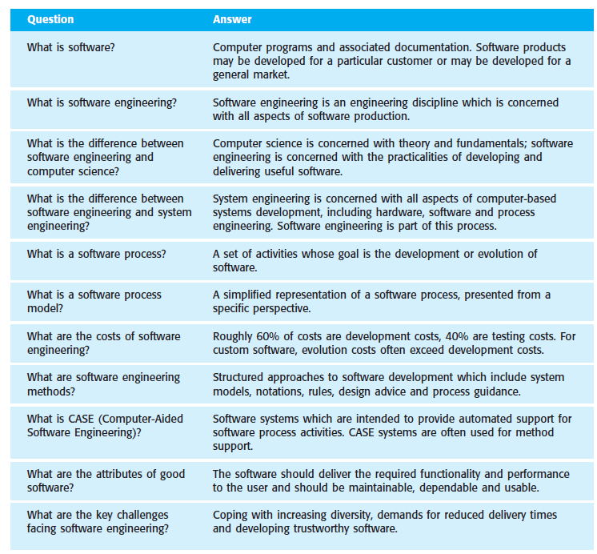

Slide 8
Software Engineering in brief
Software engineering is an engineering discipline that is concerned with all aspects of software production from the early stages of system specification to maintaining the system after it has gone into use
Idea of the software
Software Development Life Cycle (SDLC)
Requirement analysis (SRS)
Software Project management (Cocomo)
Software Design (The diagrams)
Coding and testing
Maintenance
Quality mgmt.

Slide 9
What is a software process?
A software process is the set of activities and associated results that produce a software product.
When you work to build a product or system, it’s important to go through a series of predictable steps—a road map that helps you create a timely, high-quality result. The road map that you follow is called a “software process
There are four fundamental process activities that are common to all software processes. These are:
Software specification where customers and engineers define the software to be produced and the constraints on its operation.
Software development where the software is designed and programmed.
Software validation where the software is checked to ensure that it is what the customer requires.
Software evolution where the software is modified to adapt it to changing customer and market requirements.

Slide 10
What is a software process model?
A software process model is a simplified description of a software process that presents one view of that process.
Process models may include activities that are part of the software process, software products and the roles of people involved in software engineering. Some examples of the types of software process model that may be produced are:
A workflow model: This shows the sequence of activities in the process along with their inputs, outputs and dependencies. The activities in this model represents human actions.
An activity model: This represents the process as a set of activities, each of which carries out some data transformation. It shows how the input to the process, such as a specification, is transformed to an output, such as a design. The activities here may represent transformations carried out by people or by computers.
A role/action model: This represents the roles of the people involved in the software process and the activities for which they are responsible.

Slide 11
Most software process models are based on one of three general models or paradigms of software development
The waterfall approach: This takes the above activities and represents them as separate process phases such as requirements specification, software design, implementation, testing and so on. After each stage is defined it is ‘signed-off’, and development goes on to the next stage.
Iterative development: This approach interleaves the activities of specification, development and validation. An initial system is rapidly developed from very abstract specifications. This is then refined with customer input to produce a system that satisfies the customer’s needs. The system may then be delivered. Alternatively, it may be reimplemented using a more structured approach to produce a more robust and maintainable system.
Component-based software engineering (CBSE): This technique assumes that parts of the system already exist. The system development process focuses on integrating these parts rather than developing them from scratch.

Slide 12
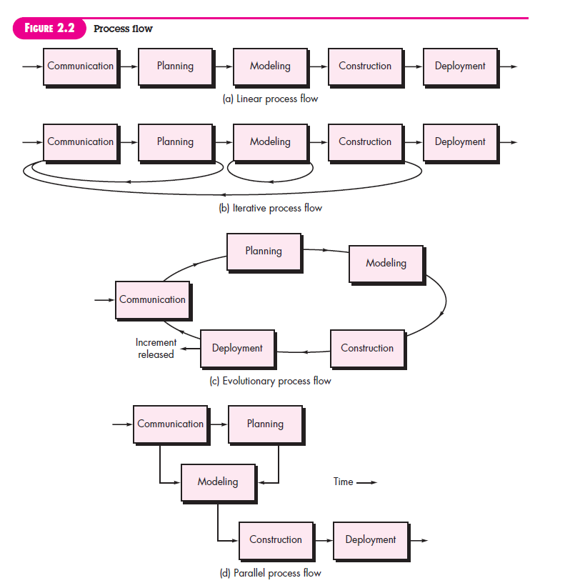

Slide 13
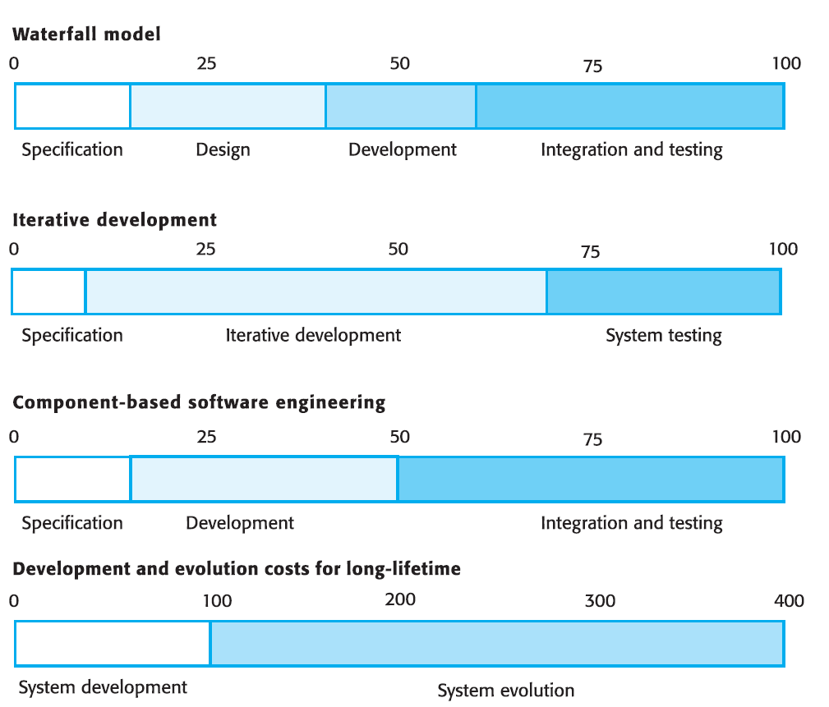
What are the costs of software engineering?
distribution of costs across the different activities in the software process depends on the process used and the type of software that is being developed
real-time software usually requires more extensive validation and testing than web-based systems
If you assume that the total cost of developing a complex software system is 100 cost units then the Figure illustrates how these are spent on different process activities.

Slide 14
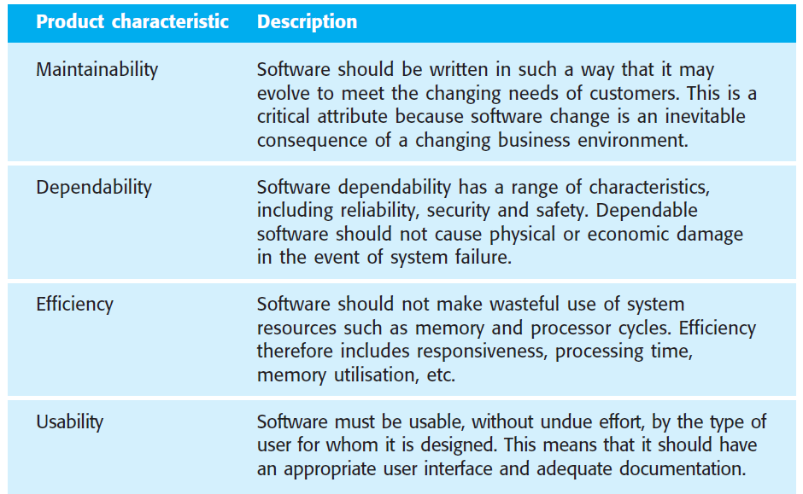
What are the attributes of good software?
As well as the services that it provides, software products have a number of other associated attributes that reflect the quality of that software,
It should reflect its behaviour while it is executing and the structure and organisation of the source program and associated documentation.

Slide 15
What are the key challenges facing software engineering?
The heterogeneity challenge Increasingly, systems are required to operate as distributed systems across networks that include different types of computers and with different kinds of support systems
The delivery challenge Many traditional software engineering techniques are time-consuming. The time they take is required to achieve software quality. The delivery challenge is the challenge of shortening delivery times for large and complex systems without compromising system quality.
The trust challenge As software is intertwined with all aspects of our lives, it is essential that we can trust that software

Slide 16
Professional and ethical responsibility
Confidentiality You should normally respect the confidentiality of your employers or clients irrespective of whether a formal confidentiality agreement has been signed.
Competence You should not misrepresent your level of competence. You should not knowingly accept work that is outside your competence.
Intellectual property rights You should be careful to ensure that the intellectual property of employers and clients is protected.
Computer misuse You should not use your technical skills to misuse other people’s computers. Computer misuse ranges from relatively trivial (game playing on an employer’s machine, say) to extremely serious (dissemination of viruses).

Slide 17
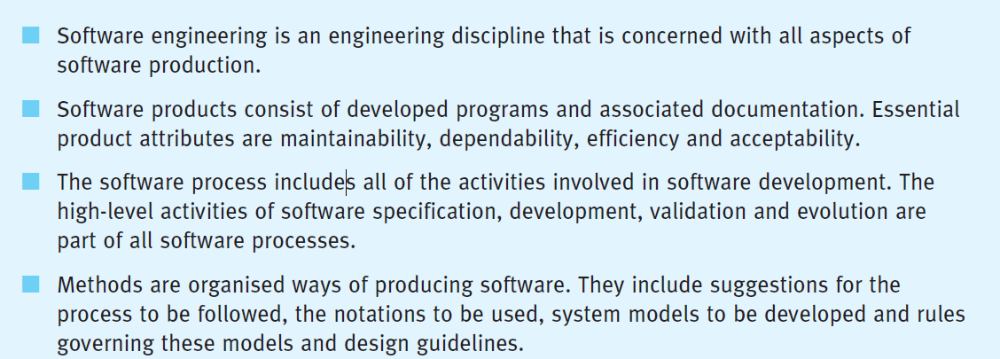
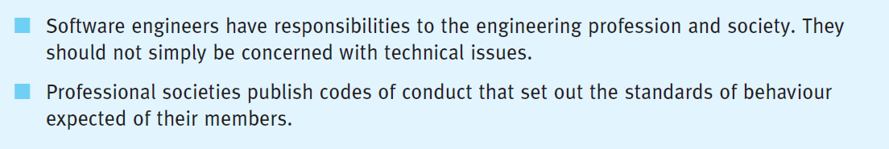
Take Away

